Slide 1
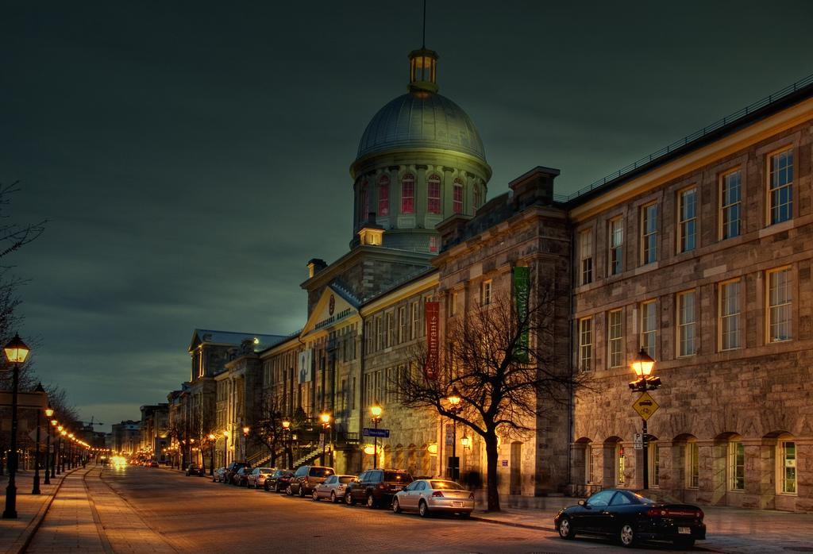
Québec & Montréal
June 17 - 24, 2019

Slide 2
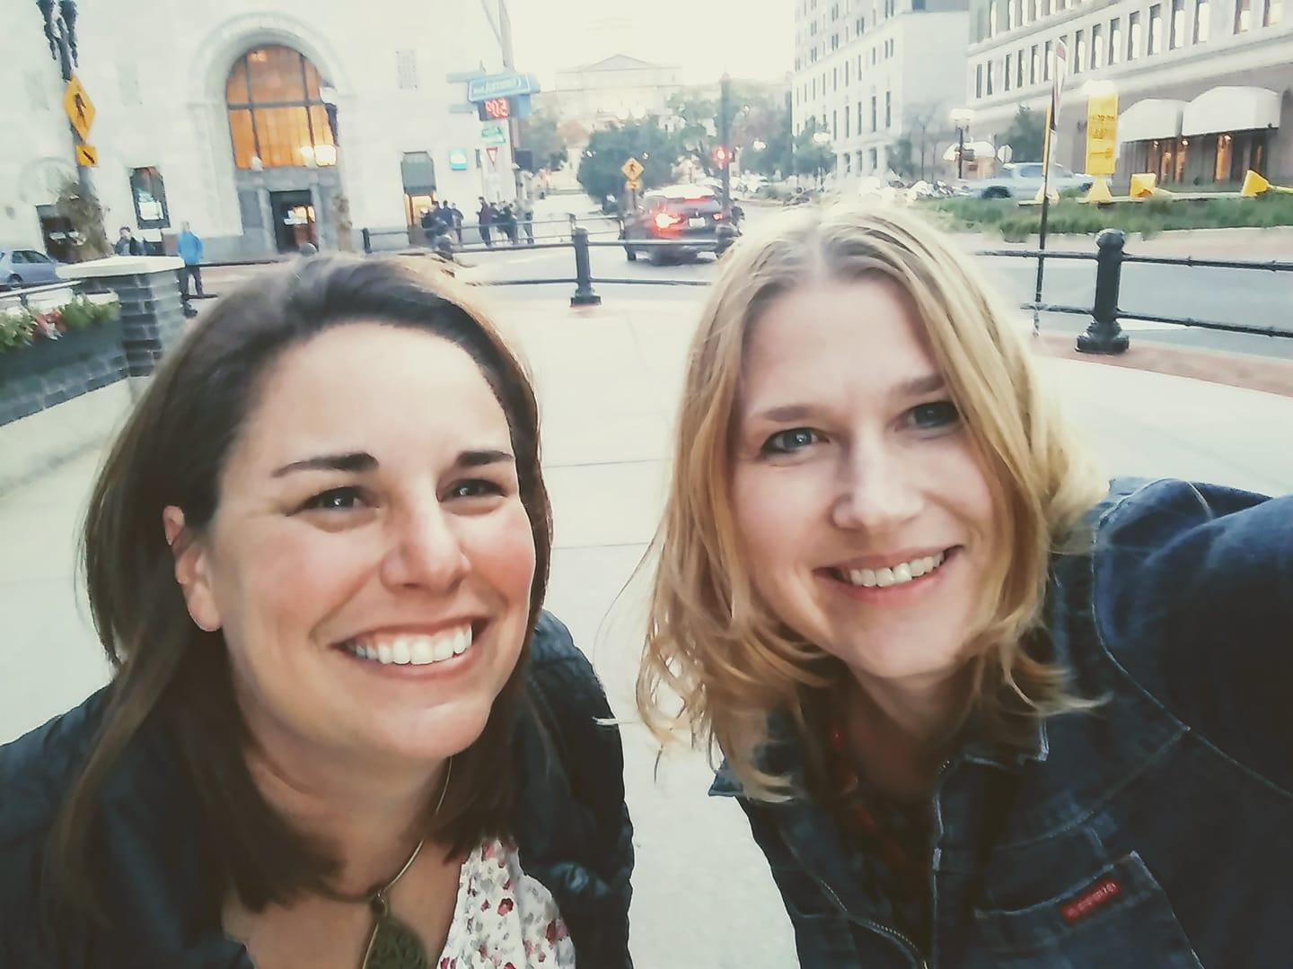
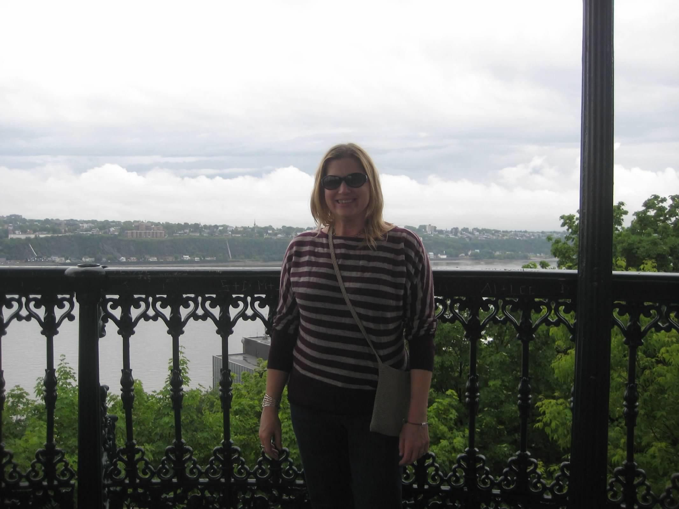
Why Do We Travel?
About Mrs. Boven & Mrs. Trahan
Mrs. Boven
Traveled to Europe in high school
Studied in Quebec in college
Studied in Costa Rica in college
Mrs. Trahan
Traveled to Canada & Europe in high school
Studied in France in college
Has led tours to Europe and Canada since 2002
Why we chose this tour:
Close to home
Less expensive
Great itinerary! Mrs. Trahan has done this tour before
Insert Photo of Yourself
the experience is everything

Slide 3
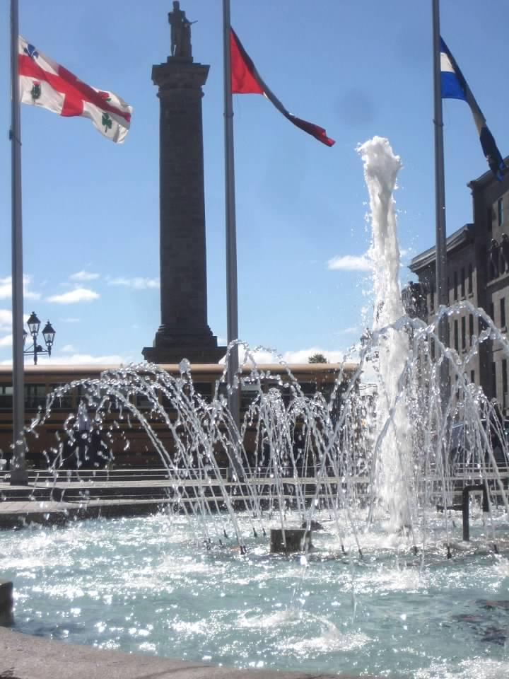
Passports
Link to forms on :
Check out tour & passport info @ www.mrstrahan.weebly.com

Slide 4
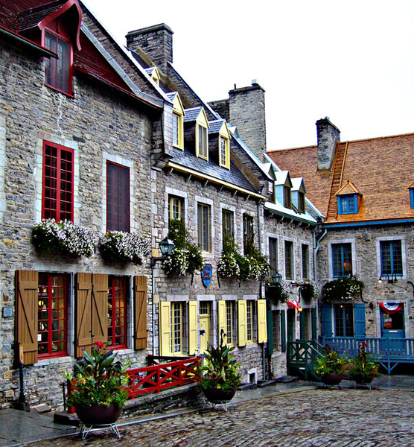
Why Should You Travel?
The Experience is Everything
Educational travel is a vital part of a
complete education. It expands views,
promotes understanding, and provides
first-hand experiences of classroom
lessons.
The majority of individuals that participated
in youth travel directly credit their travel
experiences as positively impacting their
education and career.
the experience is everything

Slide 5
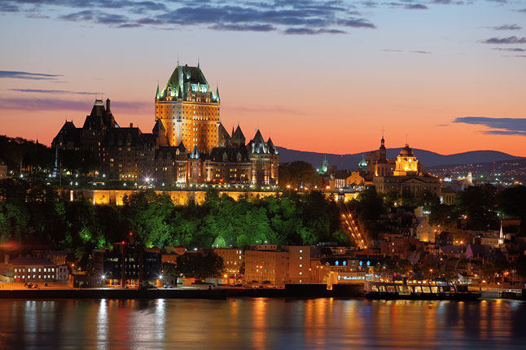
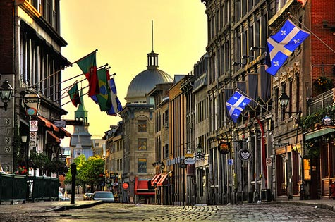
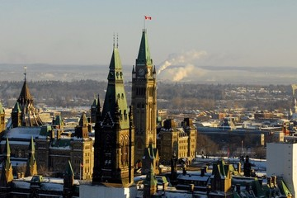
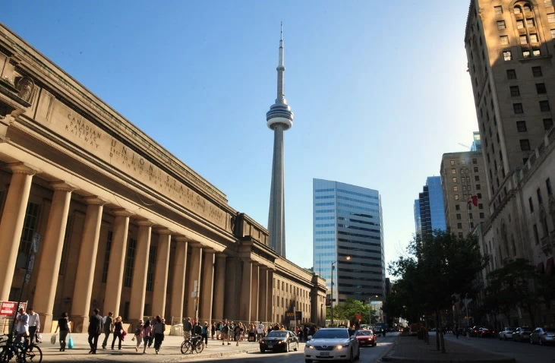
Highlights of What We’ll See
Québec City
Montréal
Ottawa
Toronto

Slide 6
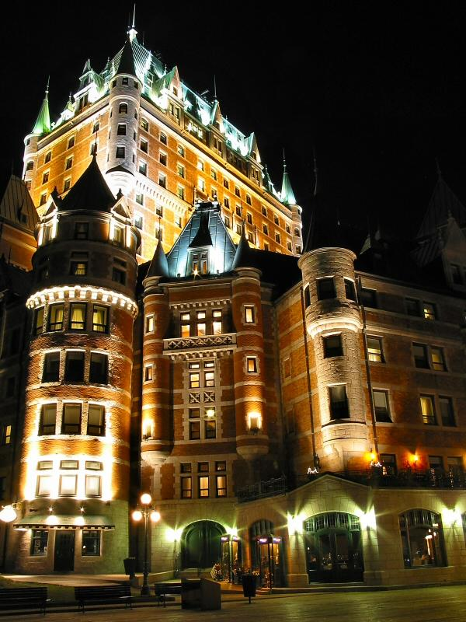
Tour Itinerary
Day 1 Bonjour Québec
Meet your Tour Director
Travel to Québec City
Québec City Walk: Dufferin Terrace, Old Québec & Château Frontenac
Dinner at a crêperie
Day 2 Québec City Landmarks
Breakfast
Québec Tour Director-Led Sightseeing: l'Escalier casse-cou (Breakneck Steps), Notre Dame des Victoires, Rue St Jean
Musée du Fort visit
Plains of Abraham Battlefield Re-Enactment
Dinner
Sugar Shack excursion
the experience is everything

Slide 7
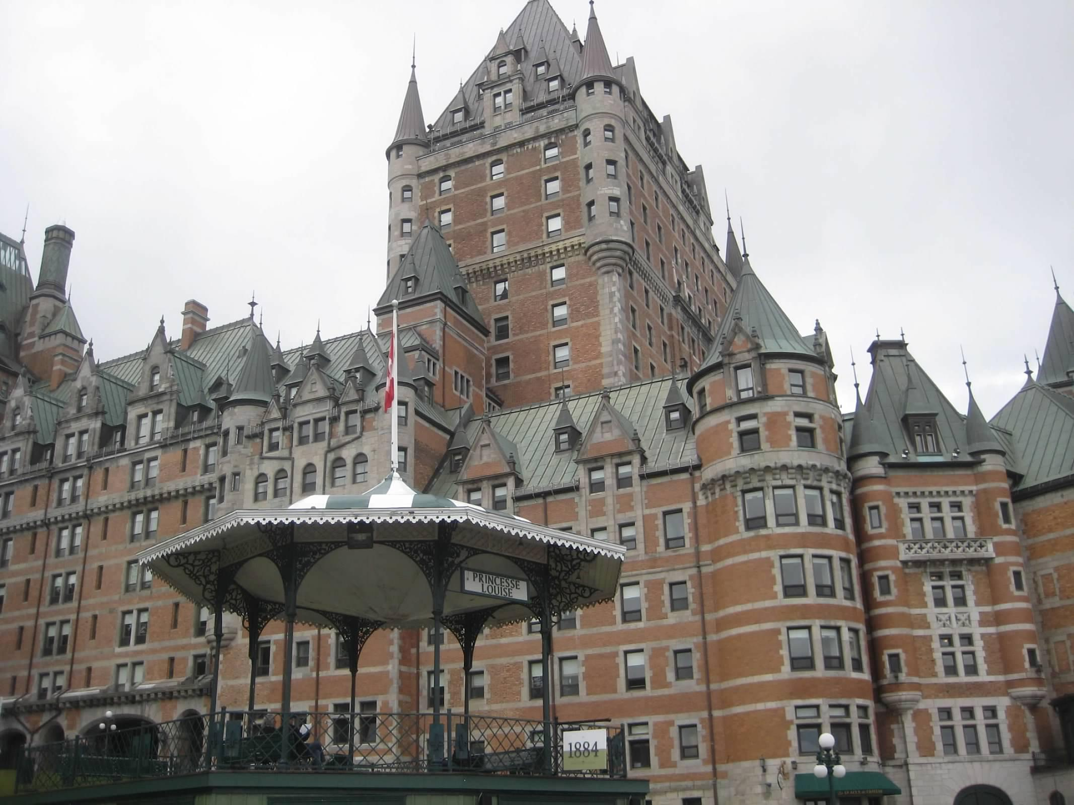
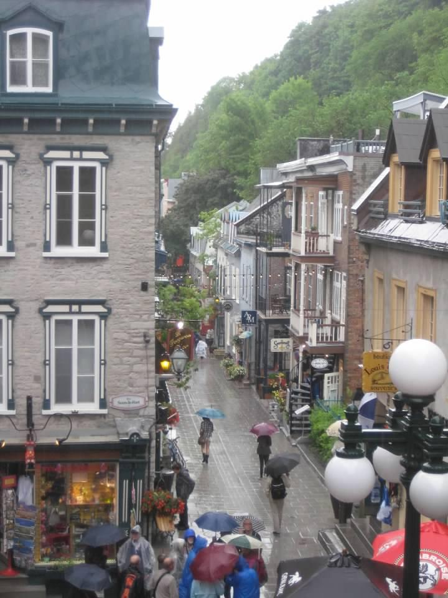
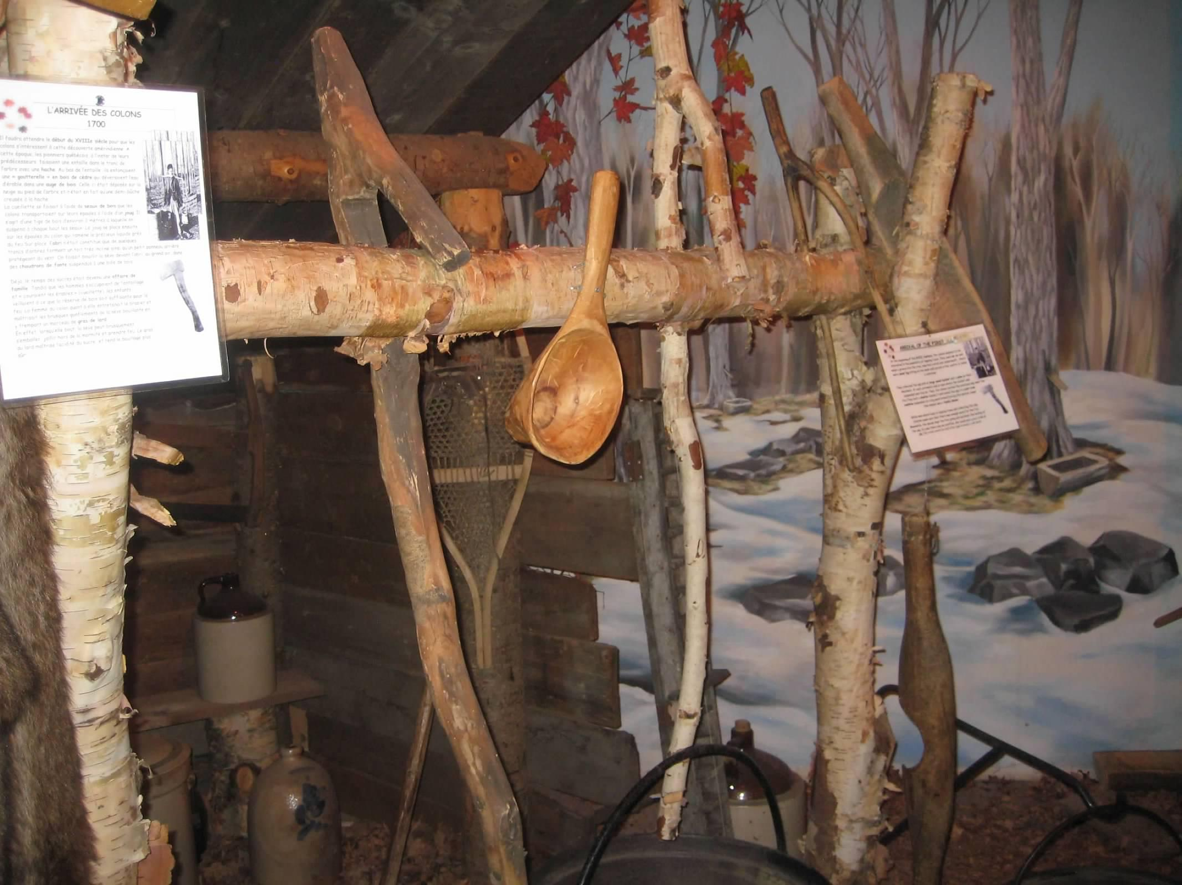

Slide 8
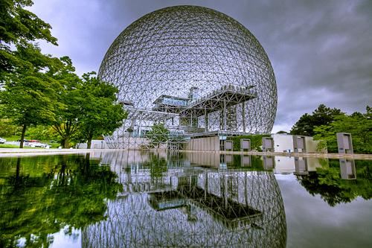
Tour Itinerary
Day 3 Québec--Montréal
Breakfast
Panoramic Tour of the Beaupré Coast
Guided tour of Basilica Ste-Anne-de-Beaupré
Montmorency Falls visit
Village des Hurons visit
Travel to Montréal along the St Lawrence River
Montréal Tour Director-Led Sightseeing: Old Montréal, McGill University, Place Ville Marie, Bell Center, Mont Royal
Dinner
Day 4 Montréal Landmarks
Breakfast
Notre-Dame Basilica visit
Montréal Museum of Archaeology: Pointe-à-Callière guided visit
Saint Joseph’s Oratory of Mount Royal
Olympic Park Tower Observatory
Montréal Science Centre visit
Dinner
the experience is everything
Notes:
Day 5 Start Extension in Ottawa and TorontoBreakfast
Travel to Ottawa
Ottawa Guided Sightseeing Tour Peace Tower, Embassy Row, Parliament Buildings & Changing of the Guard
Byward Market visit
Crime and Punishment Jail Tour
Dinner
Hotel Overnight
Day 6 Ottawa--TorontoBreakfast
Rideau Canal guided bike tour
National Gallery visit
Travel to Toronto
Toronto City Walk Yonge Street, Financial District, Old City Hall, MOCCA
CN Tower visit
Dinner
Day 7 Niagara Falls ExcursionBreakfast
Niagara Tour Director-Led Sightseeing Brock's Monument, Battle of Queenston Heights Re-Enactment
IMAX Theatre Niagara Falls - Legends and Daredevils
Maid of the Mist ride
Dinner
Day 8 End TourBreakfast
Travel home

Slide 9
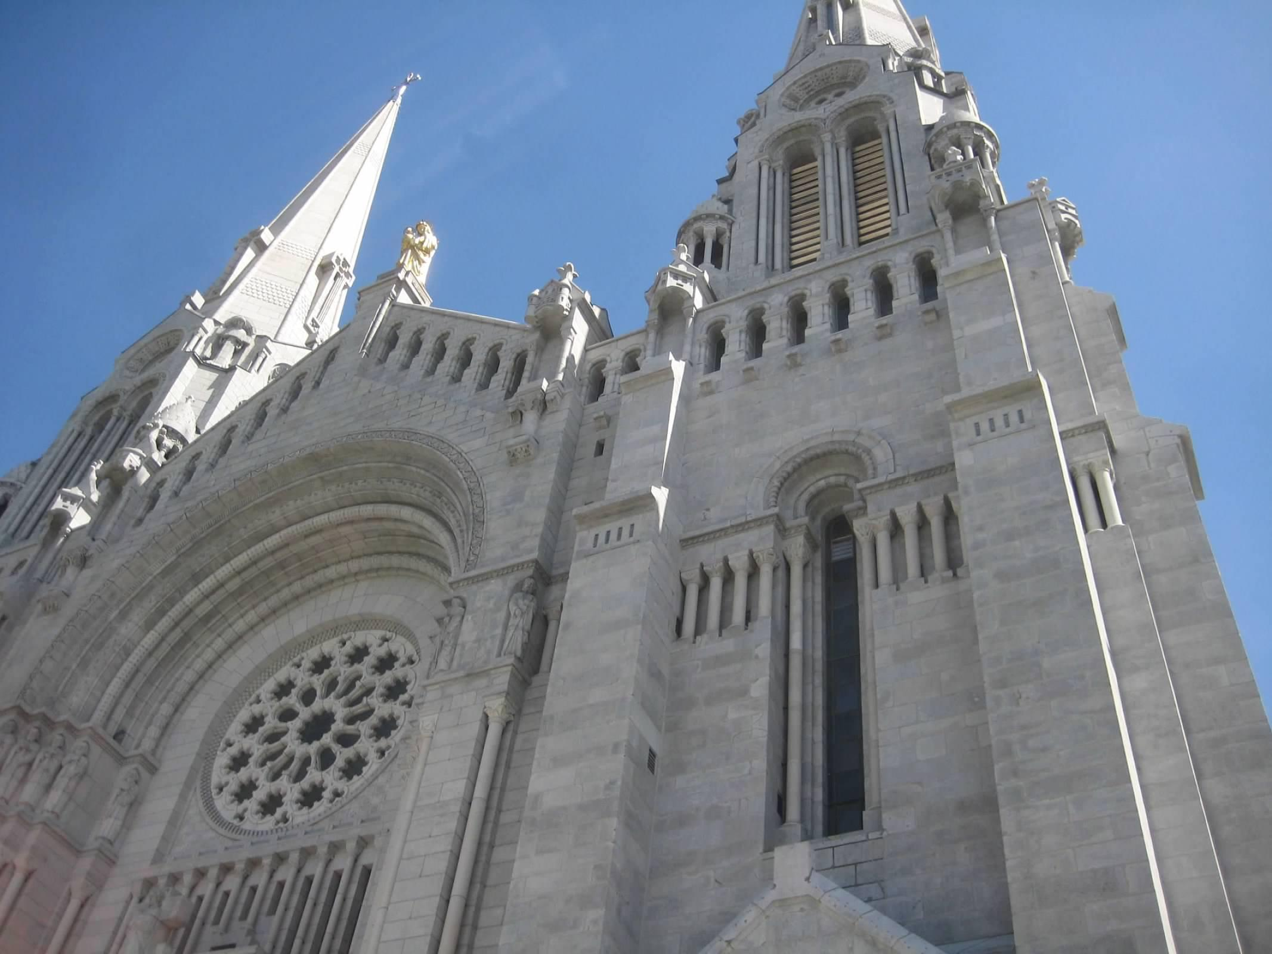
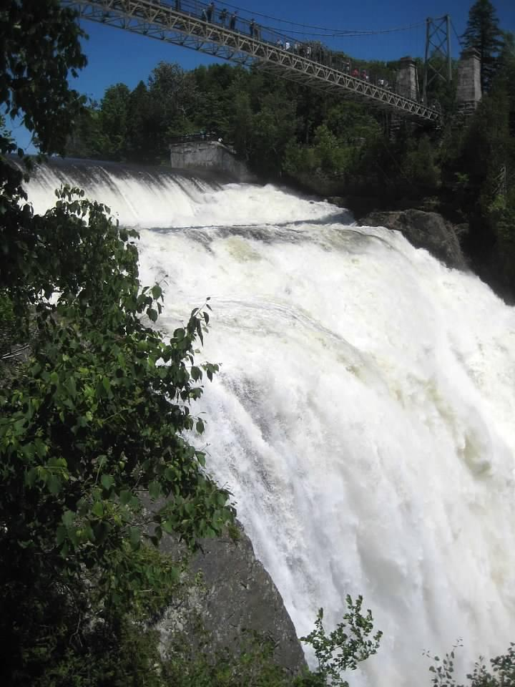
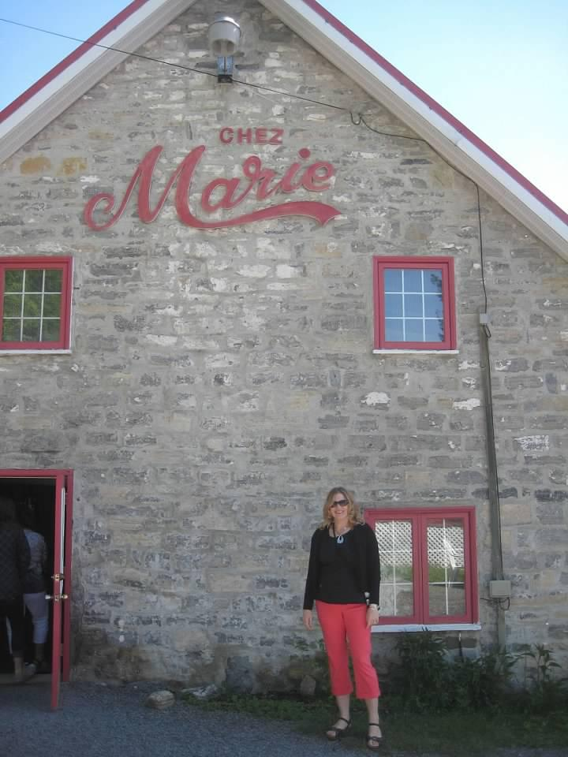

Slide 10
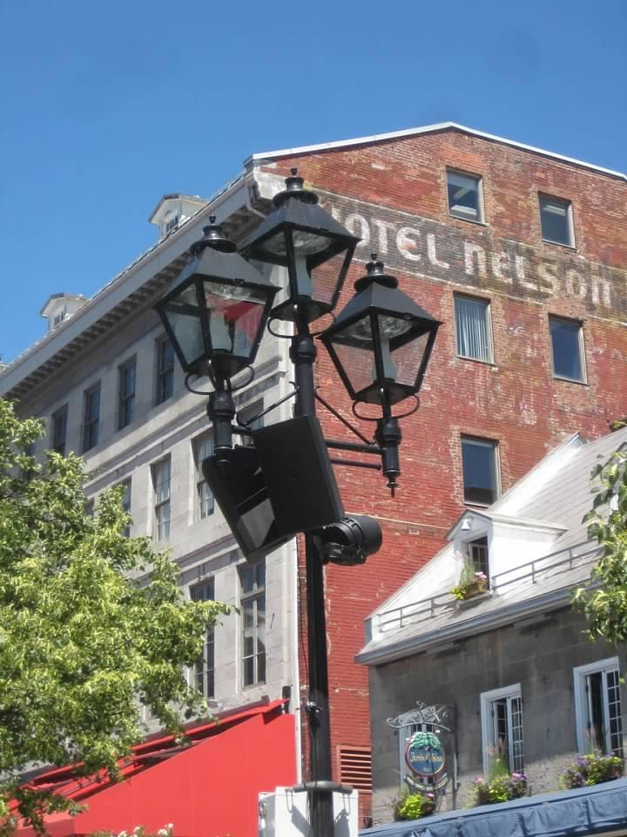
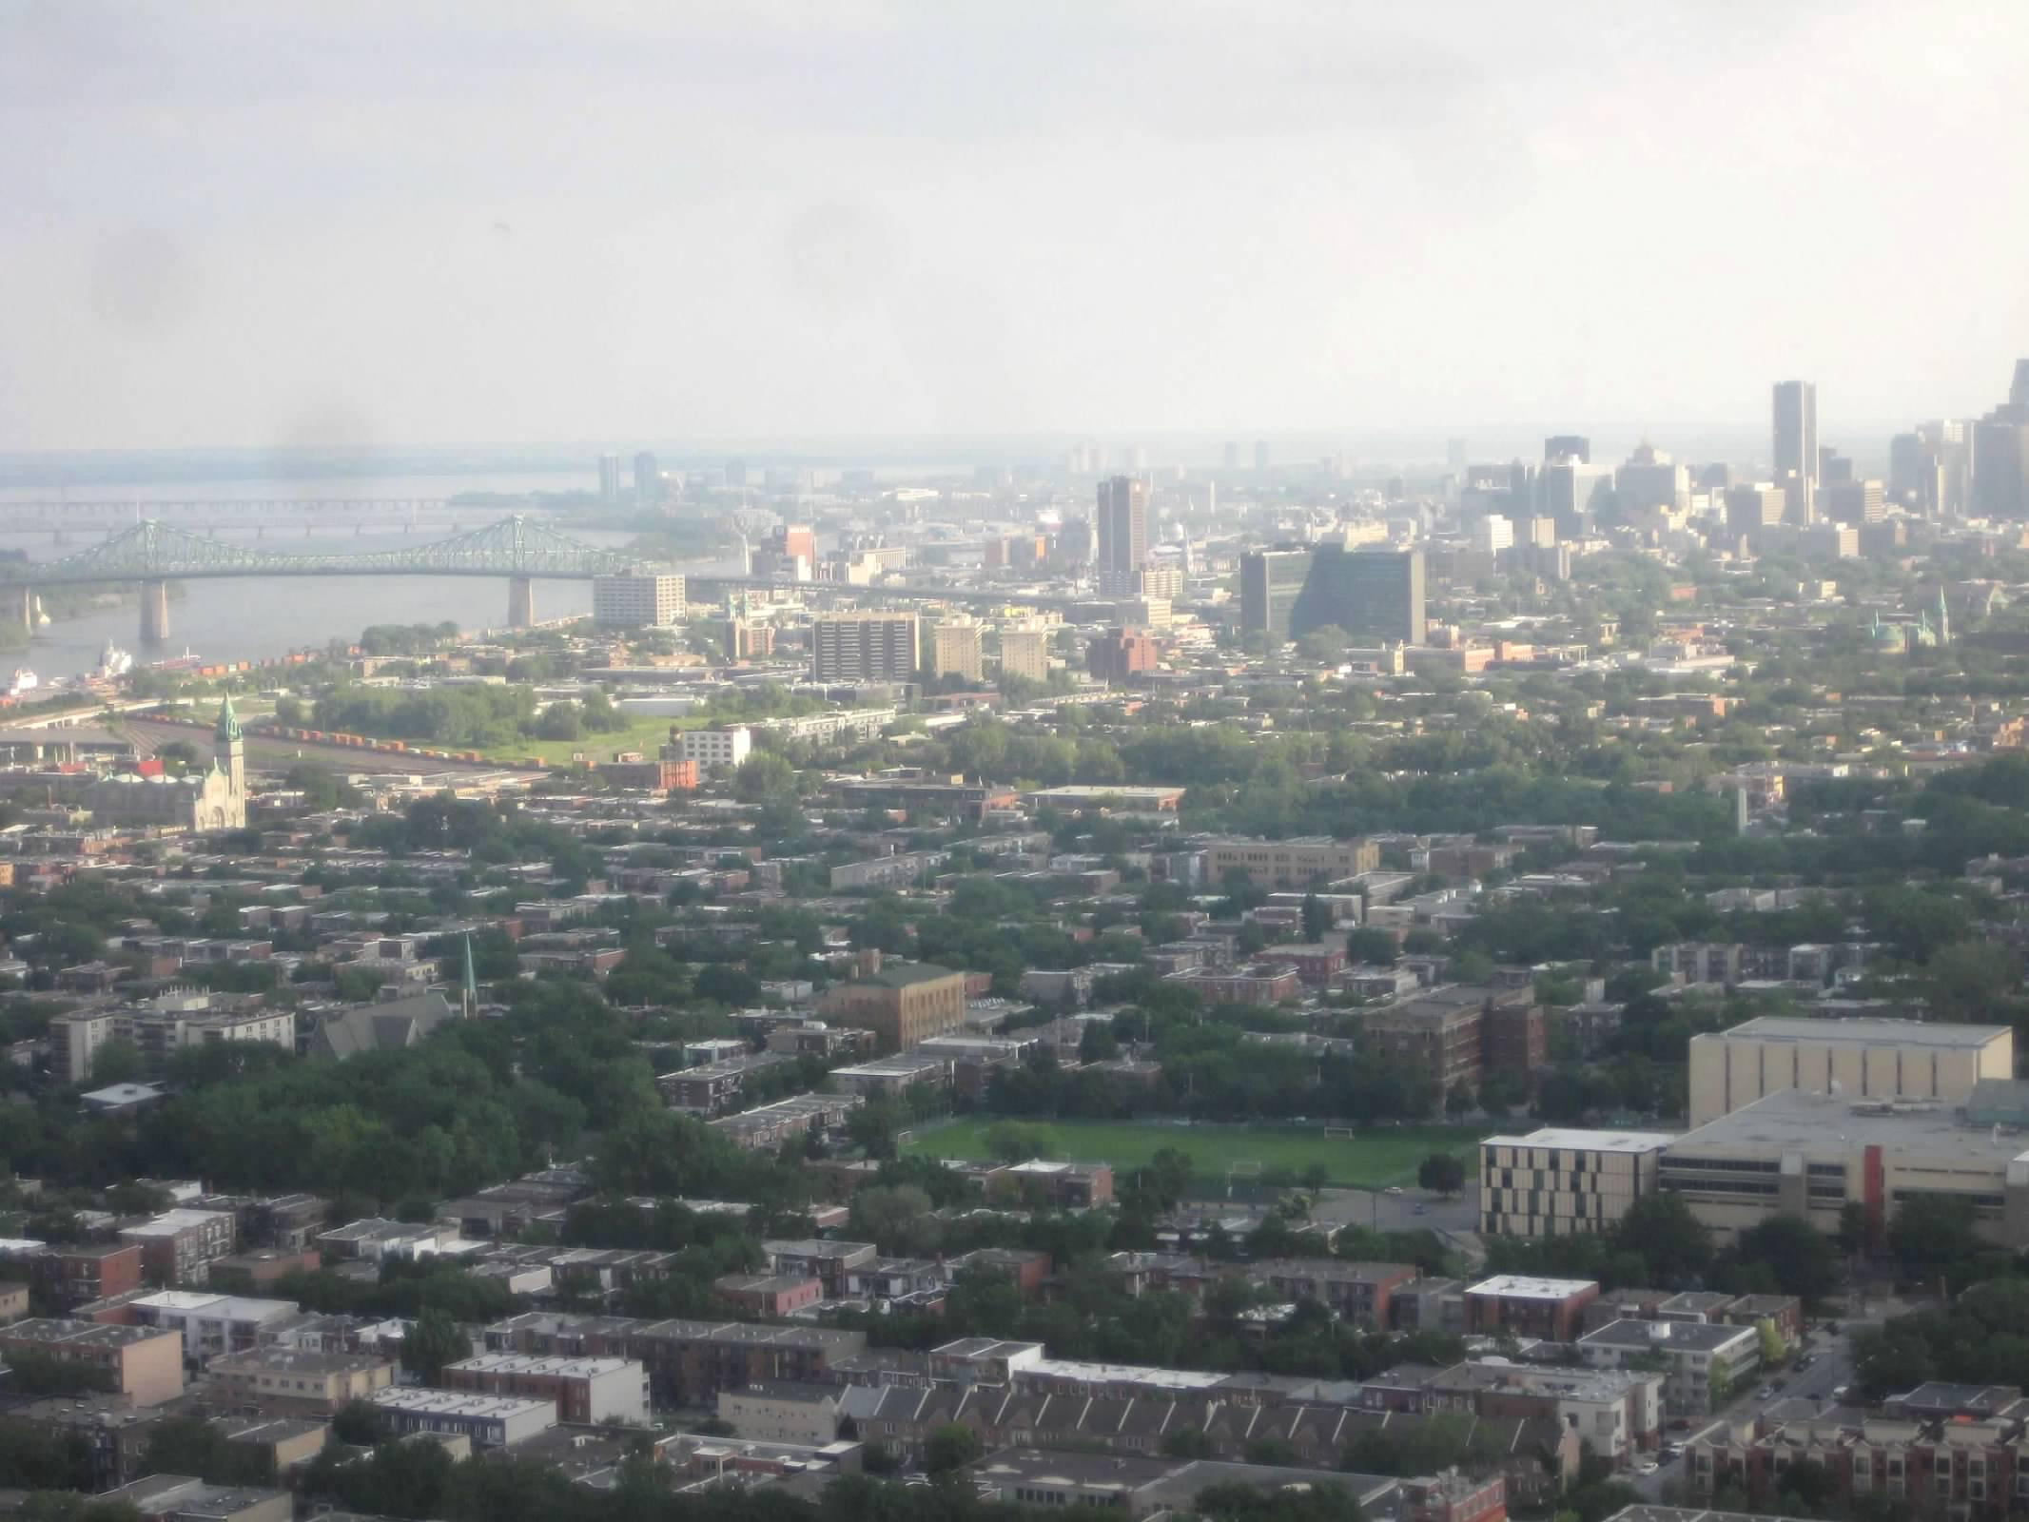
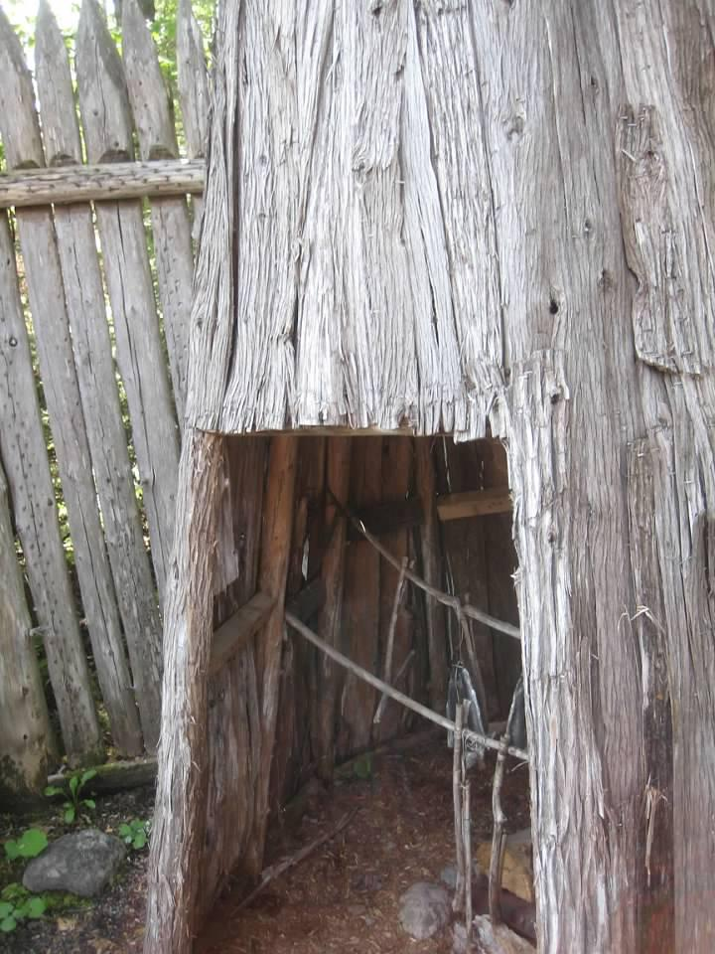
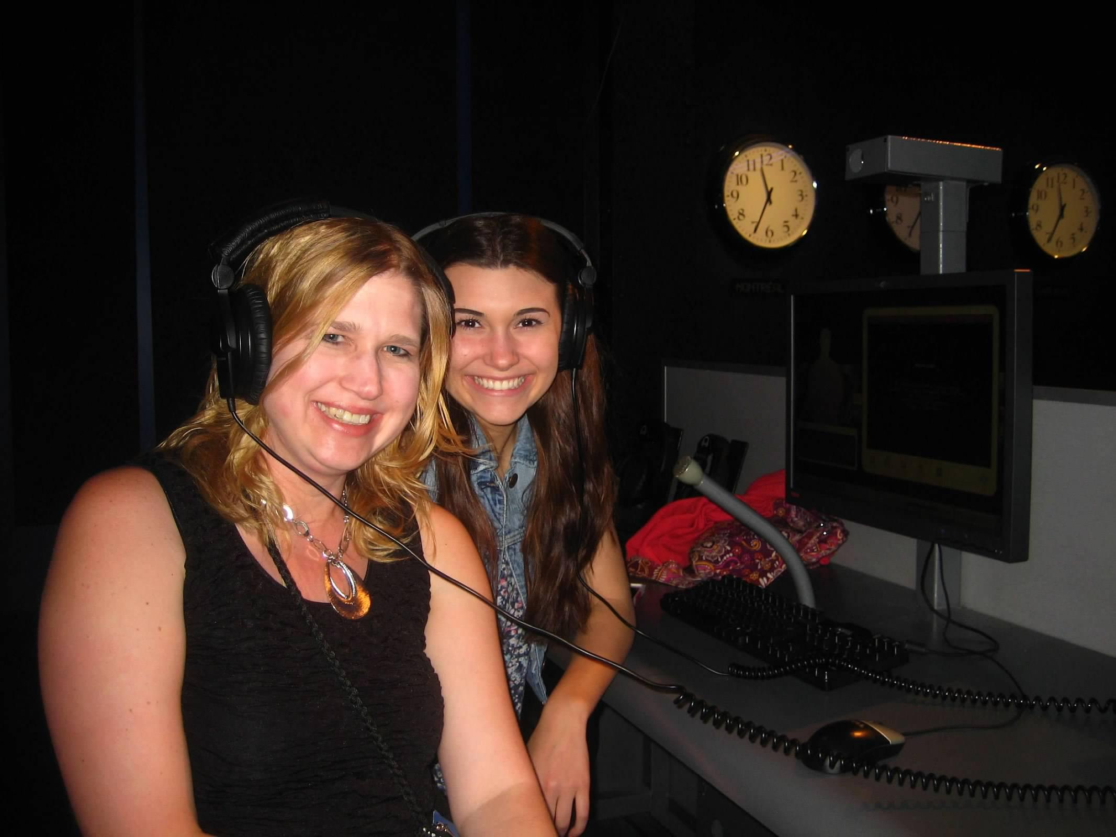

Slide 11
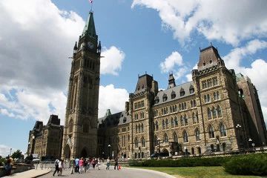
Tour Itinerary
Day 5 Start Extension to Ottawa & Toronto
Breakfast
Travel to Ottawa
Ottawa tour director-led sightseeing: Peace Tower, Embassy Row, Parliament Buildings & Changing of the Guard
Byward Market visit
Crime and Punishment Jail tour
Dinner
Day 6 Ottawa--Toronto
Breakfast
Rideau Canal guided bike tour
National Gallery visit
Travel to Toronto
Toronto city walk: Yonge Street, Financial District, Old City Hall, MOCCA
CN Tower visit
Dinner
the experience is everything
Notes:
Day 5 Start Extension in Ottawa and TorontoBreakfast
Travel to Ottawa
Ottawa Guided Sightseeing Tour Peace Tower, Embassy Row, Parliament Buildings & Changing of the Guard
Byward Market visit
Crime and Punishment Jail Tour
Dinner
Hotel Overnight
Day 6 Ottawa--TorontoBreakfast
Rideau Canal guided bike tour
National Gallery visit
Travel to Toronto
Toronto City Walk Yonge Street, Financial District, Old City Hall, MOCCA
CN Tower visit
Dinner
Day 7 Niagara Falls ExcursionBreakfast
Niagara Tour Director-Led Sightseeing Brock's Monument, Battle of Queenston Heights Re-Enactment
IMAX Theatre Niagara Falls - Legends and Daredevils
Maid of the Mist ride
Dinner
Day 8 End TourBreakfast
Travel home

Slide 12
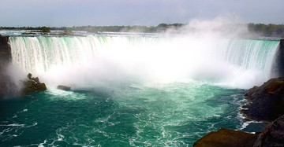
Tour Itinerary
Day 7 Niagara Falls Excursion
Breakfast
Niagara tour director-led sightseeing tour: Brock's Monument, Battle of Queenston Heights re-enactment
IMAX Theatre Niagara Falls - Legends and Daredevils
Niagara Falls cruise
Dinner
Day 8 End Tour
Breakfast
Travel home
the experience is everything
Notes:
Day 5 Start Extension in Ottawa and TorontoBreakfast
Travel to Ottawa
Ottawa Guided Sightseeing Tour Peace Tower, Embassy Row, Parliament Buildings & Changing of the Guard
Byward Market visit
Crime and Punishment Jail Tour
Dinner
Hotel Overnight
Day 6 Ottawa--TorontoBreakfast
Rideau Canal guided bike tour
National Gallery visit
Travel to Toronto
Toronto City Walk Yonge Street, Financial District, Old City Hall, MOCCA
CN Tower visit
Dinner
Day 7 Niagara Falls ExcursionBreakfast
Niagara Tour Director-Led Sightseeing Brock's Monument, Battle of Queenston Heights Re-Enactment
IMAX Theatre Niagara Falls - Legends and Daredevils
Maid of the Mist ride
Dinner
Day 8 End TourBreakfast
Travel home

Slide 13
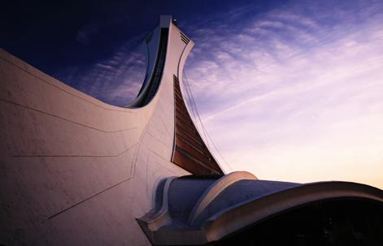
What’s Included?
Round-trip transportation
7 overnight stays in hotels with private bathrooms
Breakfast daily (except arrival day)
Dinner daily (except departure day)
Full-time services of a professional Tour Director
Guided sightseeing tours and city walks as per itinerary
Visits to select attractions as per itinerary
Overnight security chaperone
On-Tour Tipping
Tour Diary™
Note: Tour cost does not include airline-imposed baggage fees, or fees for any required passport or visa. Please visit our Fees FAQ page for a full list of items that may not be included in the cost of your tour.
the experience is everything

Slide 14
Travel With Confidence
Travel Protection
4 out of 5 Explorica travelers protect their tours with the travel protection plan.
Travel Protection Plan
$12 per day (up to a maximum of $180).
Must be purchased by your last payment.
Travel Protection Plan Plus
$18 per day (up to a maximum of $270).
Must be purchased within 14 days of enrollment.
Questions: Call Tripmate 800-888-7292 Plan # F433E
To learn more about cancel for any reason and other benefits,
go online: http://www.explorica.com/Resources/Travel-Protection-Plan.aspx
the experience is everything
Notes:
Details on Trip Mate
A traveler’s injury, sickness, or death of an immediate family member.
Theft of passport or visas.
Flight cancellations or trip interruptions due to covered reasons such as sickness, injury, or death.
Trip cancellation or trip interruption due to terrorist acts
Explorica’s Travel Protection Plan PLUS includes “Cancel For Any Reason Benefit”
Allows travelers to cancel their tour for any reason up to two days before departure and receive most of their tour fee back in cash. That means recent events such as the Ash Cloud and the H1N1 outbreak were covered under our plan.

Slide 15
Travel Protection Details
Explorica’s Travel Protection Plan covers you for:
A traveler’s injury, sickness, or death of a family member.
Loss of passport or visas.
Flight cancellations due to strike or bad weather.
Loss of luggage and personal effects.
Trip Cancellation or Trip Interruption due to covered reasons such as a covered sickness, illness, injury or death.
Trip Cancellation or Trip Interruption due to defined Terrorist Acts.
Explorica’s Travel Protection Plan Plus covers you for:
Same benefits as standard plan PLUS Cancel for Any Reason Waiver Benefit.
With the Cancel for Any Reason Waiver Benefit, if you cancel your trip for any reason not otherwise covered by this policy, TripMate will reimburse you for 75% of the non-refundable cancellation fees which apply to your trip.
Please see Terms & Conditions for complete information regarding Travel Protection Plans.
the experience is everything
Notes:
Details on Trip Mate
A traveler’s injury, sickness, or death of an immediate family member.
Theft of passport or visas.
Flight cancellations or trip interruptions due to covered reasons such as sickness, injury, or death.
Trip cancellation or trip interruption due to terrorist acts
Explorica’s Travel Protection PLUS includes “Cancel For Any Reason Benefit”
Allows travelers to cancel their tour for any reason up to two days before departure and receive most of their tour fee back in cash. That means recent events such as the Ash Cloud and the H1N1 outbreak were covered under our plan.

Slide 16
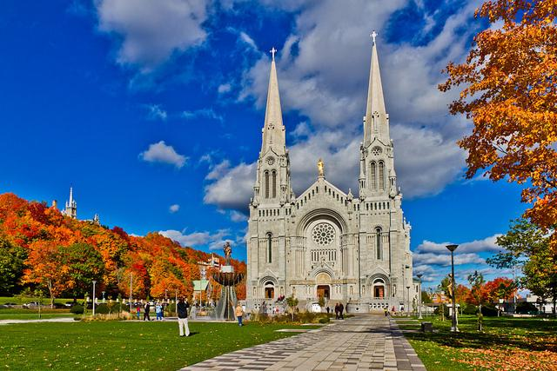
Pricing Details
See detailed pricing at: http://www.explorica.com/Trahan-5858
or
http://www.explorica.com/Boven-6388
Total Student Cost: $1,903.00* Adults (23+) add $360
*Enroll on or before November 30^{th,} 2018 and use the scholarship Travel2019 to sign up at this price!
*Have you traveled with Explorica before? Then take an additional $50 off the tour cost!
the experience is everything

Slide 17
Payment Options
Automatic Monthly Payment Plans
$50 deposit and any selected travel protection costs at registration.
Balance is divided into equal monthly payments.
All payments billed automatically to credit card or checking account.
Manual Payment Plan – 3 step
Payments are divided into three timed steps:
$99 deposit and any selected travel protection costs at registration.
$300 due 30 days later
Full balance is due 95 days prior to departure.
Manual Payments by check or credit card.
Pay in Full
Entire balance paid upon registration
Payments by check or credit card
the experience is everything

Slide 18
Enrolling Online is Easy
Visit www.explorica.com
Find the “Students: Sign Up” button and then click to go to the next page
the experience is everything

Slide 19
Enter the Tour Center ID
Trahan-5858
or
Boven-6388
the experience is everything

Slide 20
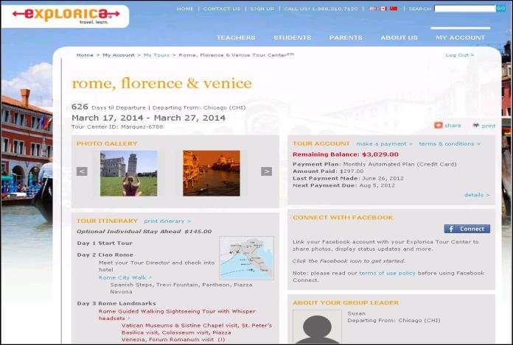
Easy Online Payments
the experience is everything
Notes:
Travelers get their own individual Explorica accounts with username and passwords. The search engine let’s you find quick and easy answers to your questions. Everything you could need is online.

Slide 21
Online Tour Diary
Watch your travelers on tour day by day. Share your tour diary with friends & family!
the experience is everything

Slide 22
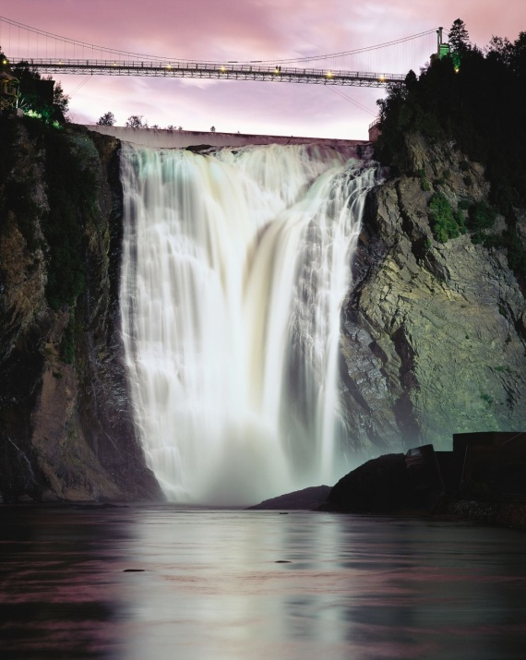
Contact Explorica
Email
info@explorica.com
Mail
Explorica, Inc. 145 Tremont St., Fl. 6 Boston, MA 02111
Fax
1.888.310.7088
Phone
1.888.310.7121
the experience is everything

Slide 23
Questions?

